Slide 1
CSE 202 - Discrete Mathematics II

Slide 2
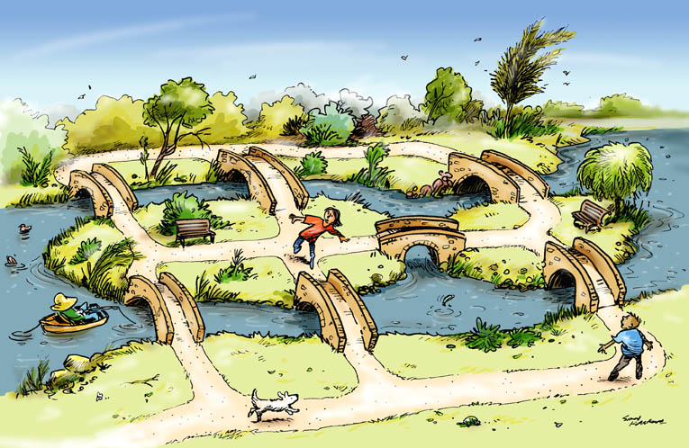
Seven Bridges of Königsberg

Slide 3
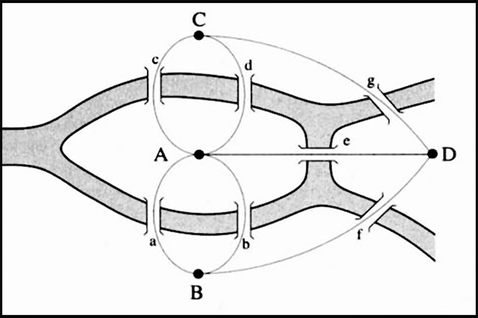
Seven Bridges of Königsberg

Slide 4
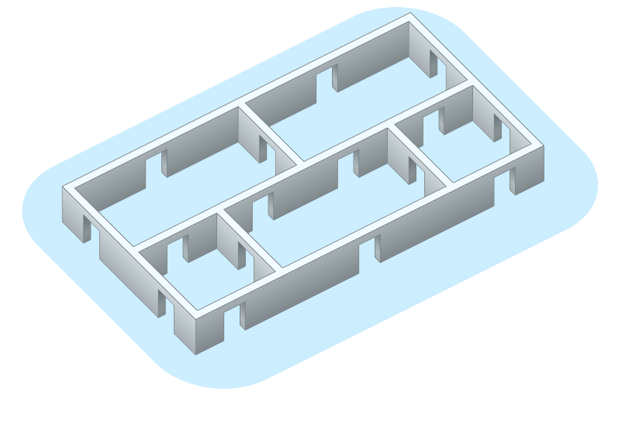
Is it possible to go through all the doors provided that each door is passed through only once?

Slide 5
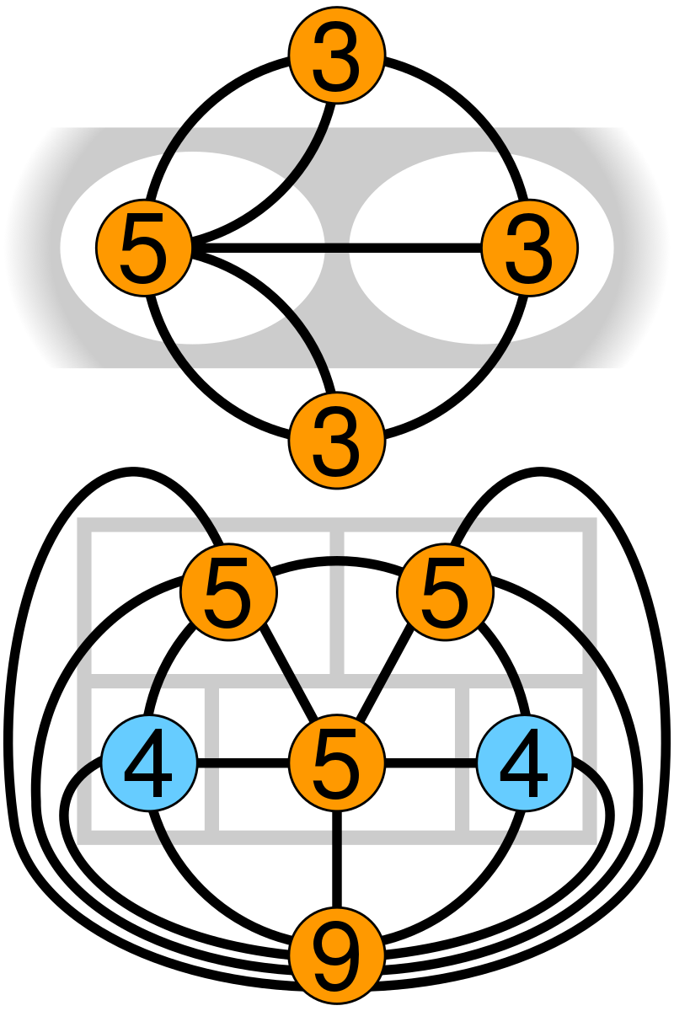

Slide 6
Graph theory
The basic idea of graphs were first introduced in the 18th century (1735) by Swiss mathematician Leonhard Euler on “Seven Bridges of Königsberg”
In Mathematics, it is a sub-field that deals with the study of graphs. Graph theory is the study of relationship between the vertices (nodes) and edges (lines).

Slide 7
Definition
A graph is an ordered triple G=(V, E,ϕ)
V, a set of vertices (also called nodes or points);
E, a set of edges (also called links or lines);
ϕ: E →{{x, y} ∣ x,y ∈V} an incidence function mapping every edge to a pair of vertices

Slide 8
Course Description
Graph theory has a wide range of applications in software engineering and computer networks.
The course provides the concepts and theorems of graph and tree, related algorithms and applications, including depth first search, breadth first search, single shortest path, minimum spanning tree, binary search tree, balanced binary tree.
The course also develops methods and skills to identify problems, create models for the problems in graph language, design data structures to represent the problem, then apply appropriate algorithms to solve the problem.

Slide 9
Discrete Math 2
Prerequisites
Data Structure and Algorithms
Object Oriented Programming
Be prerequisites of:
Analysis and design algorithms

Slide 10
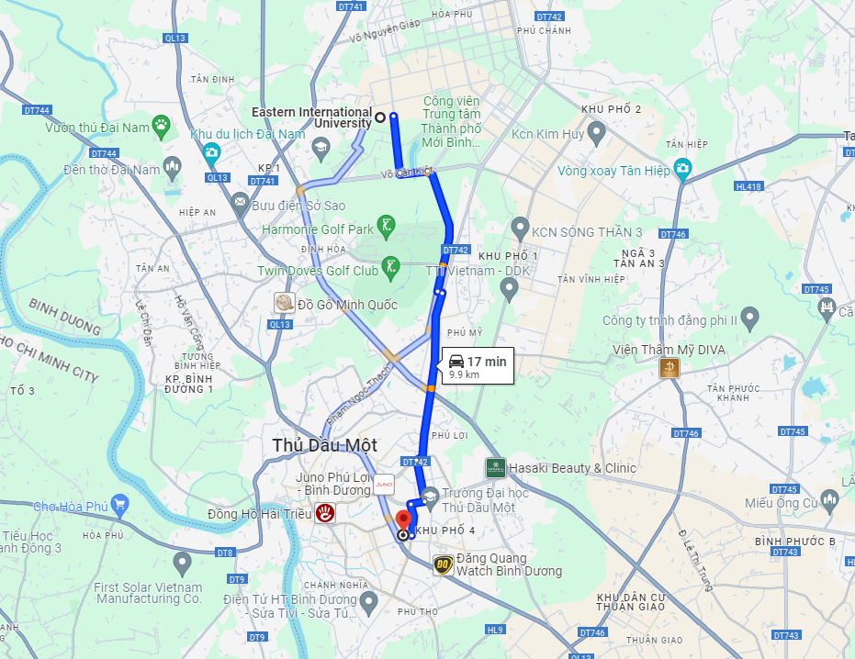

Slide 11
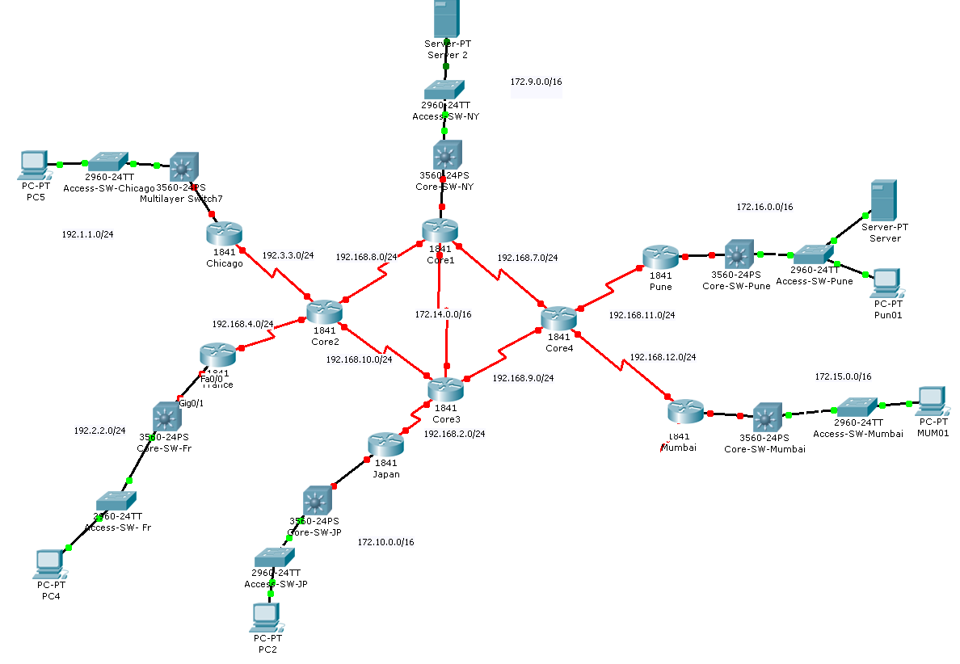

Slide 12
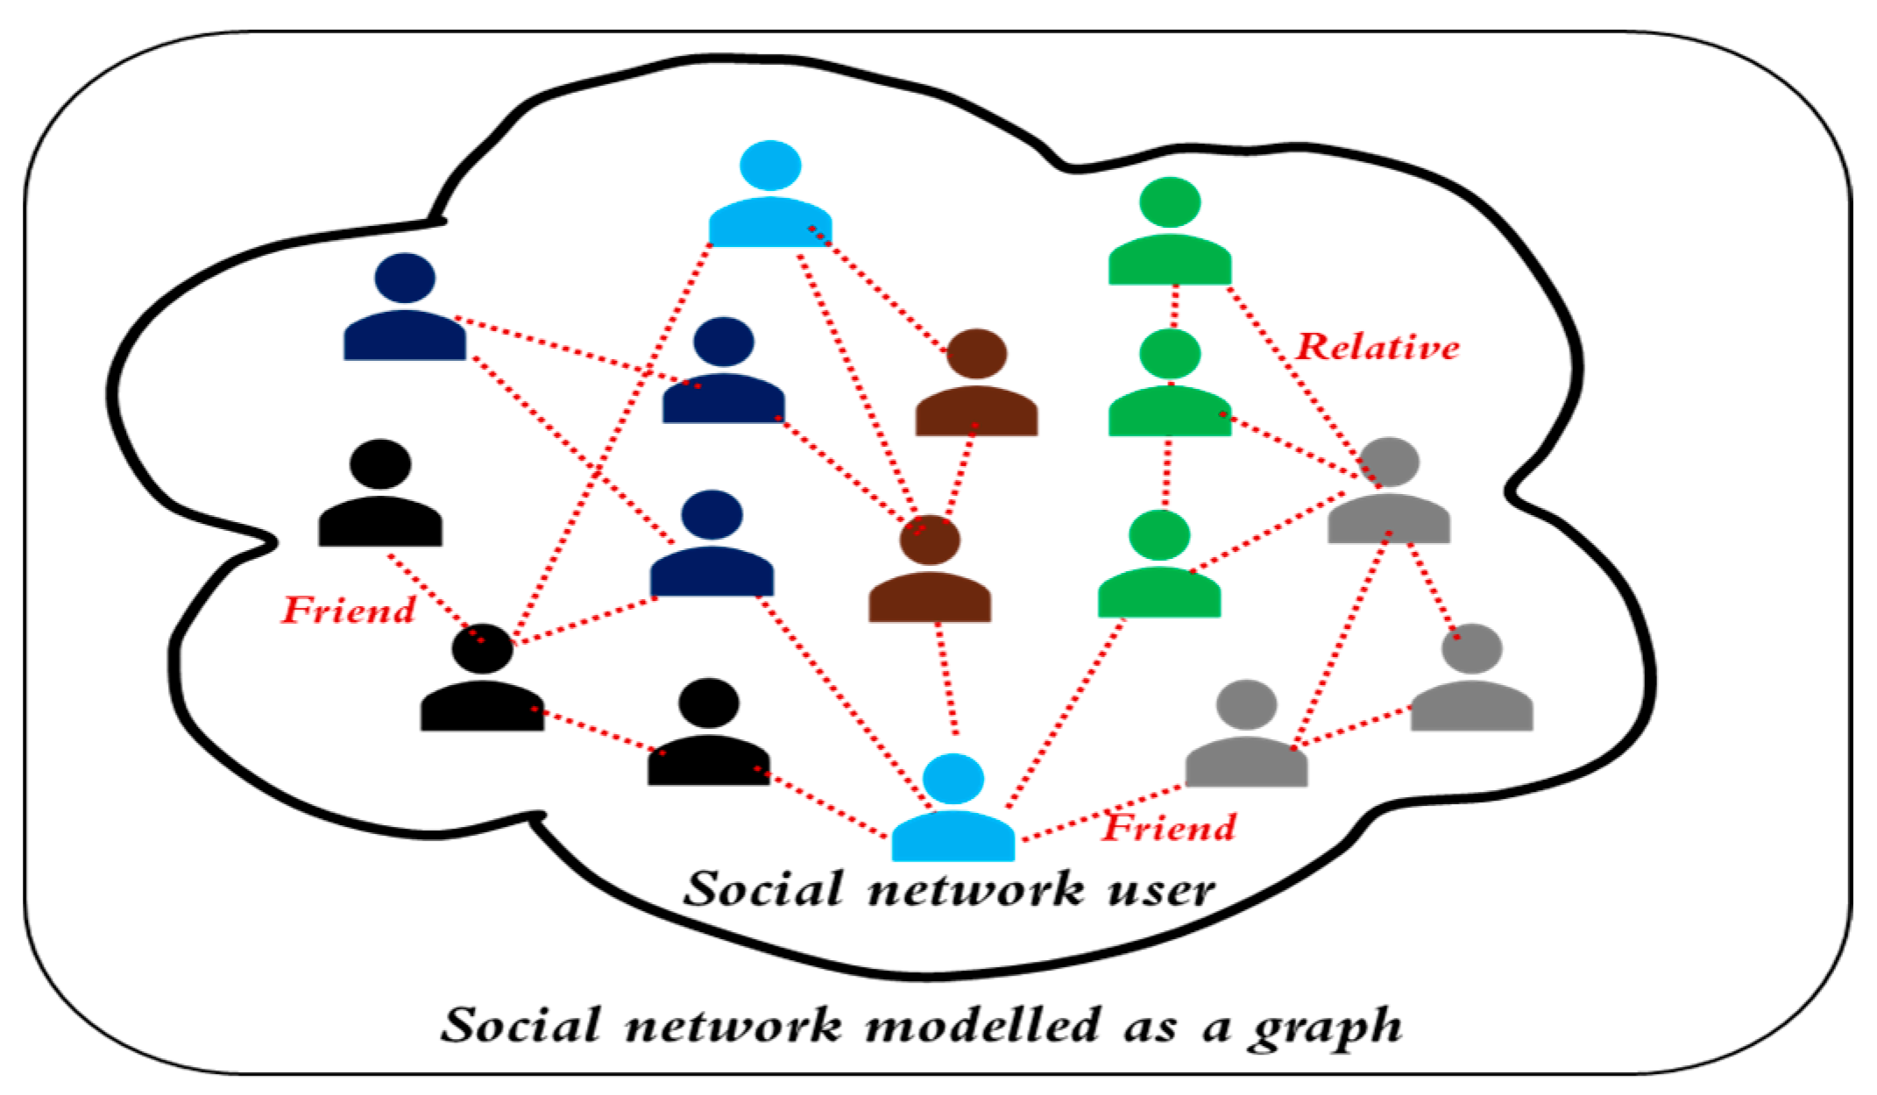
Social Network

Slide 13
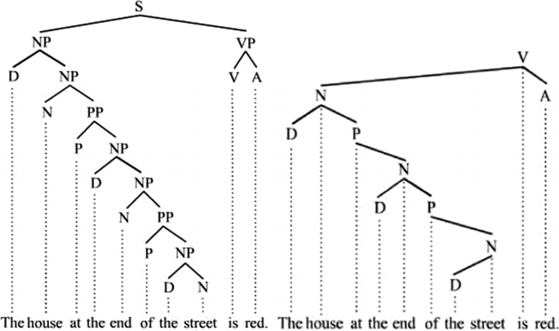
Linguistics

Slide 14
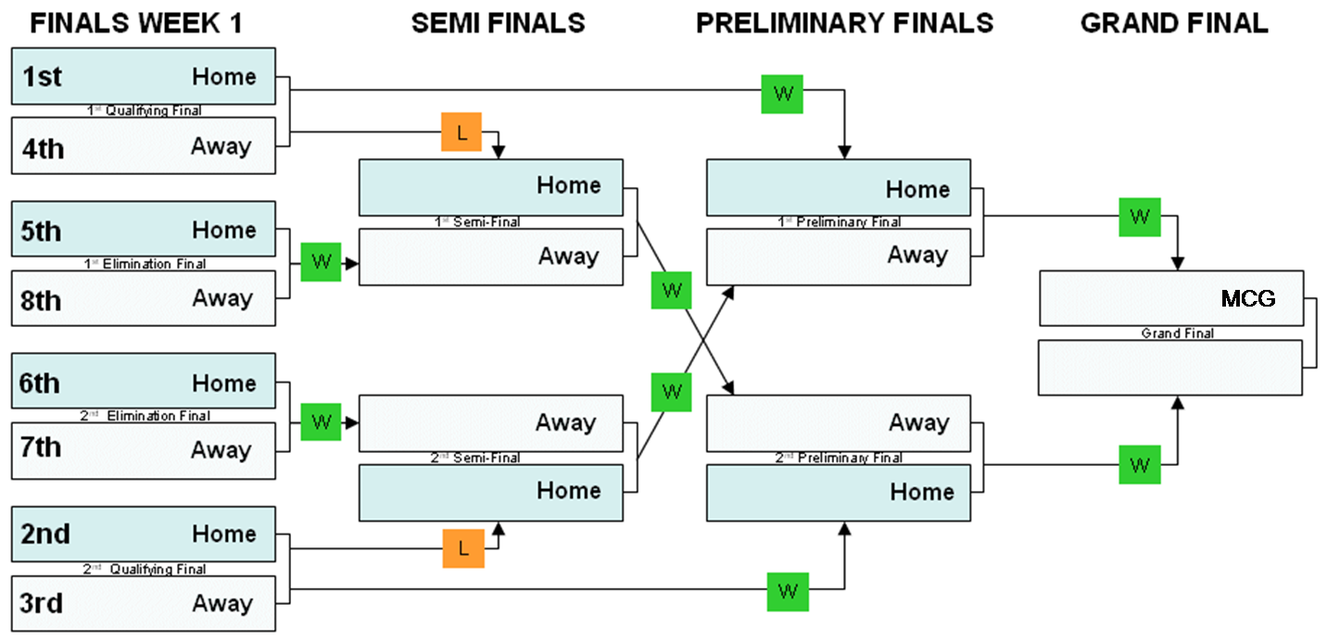

Slide 15
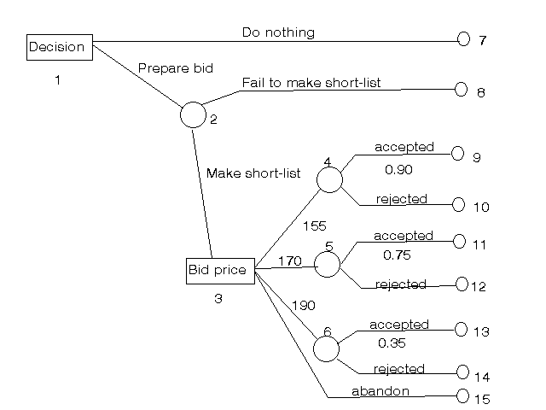

Slide 16
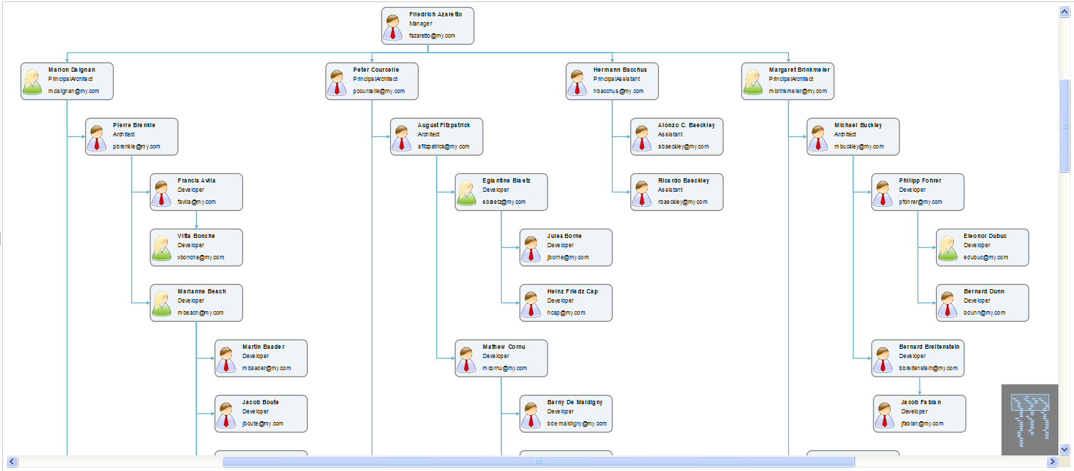

Slide 17
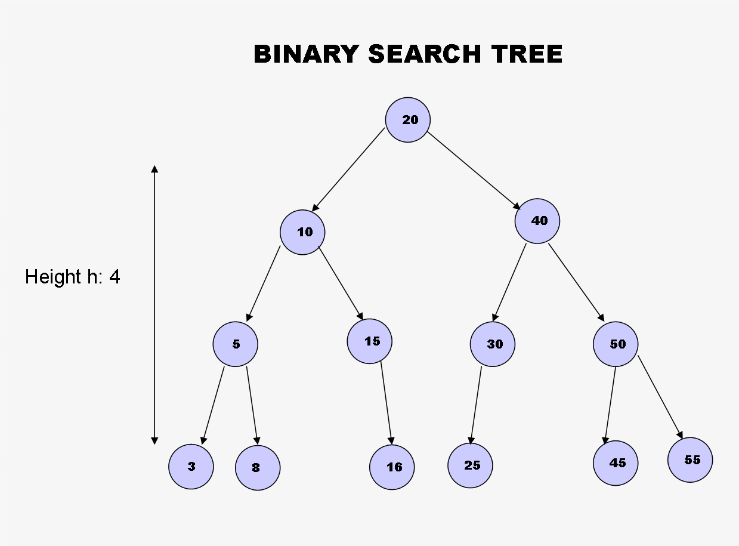

Slide 18
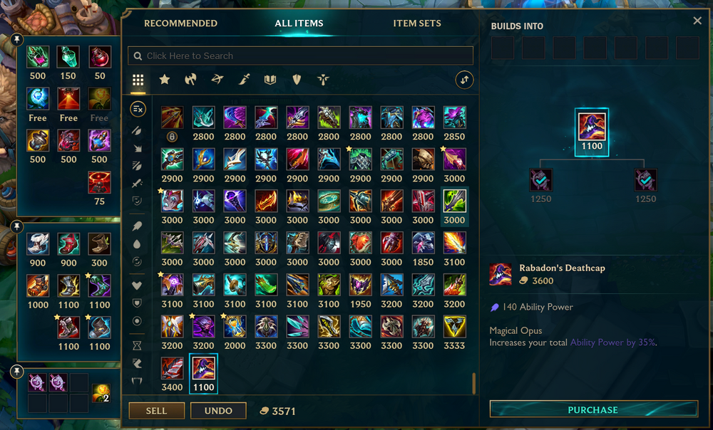
Applications in game

Slide 19
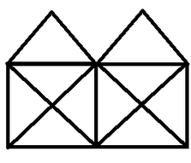
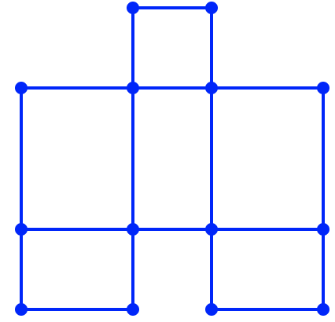
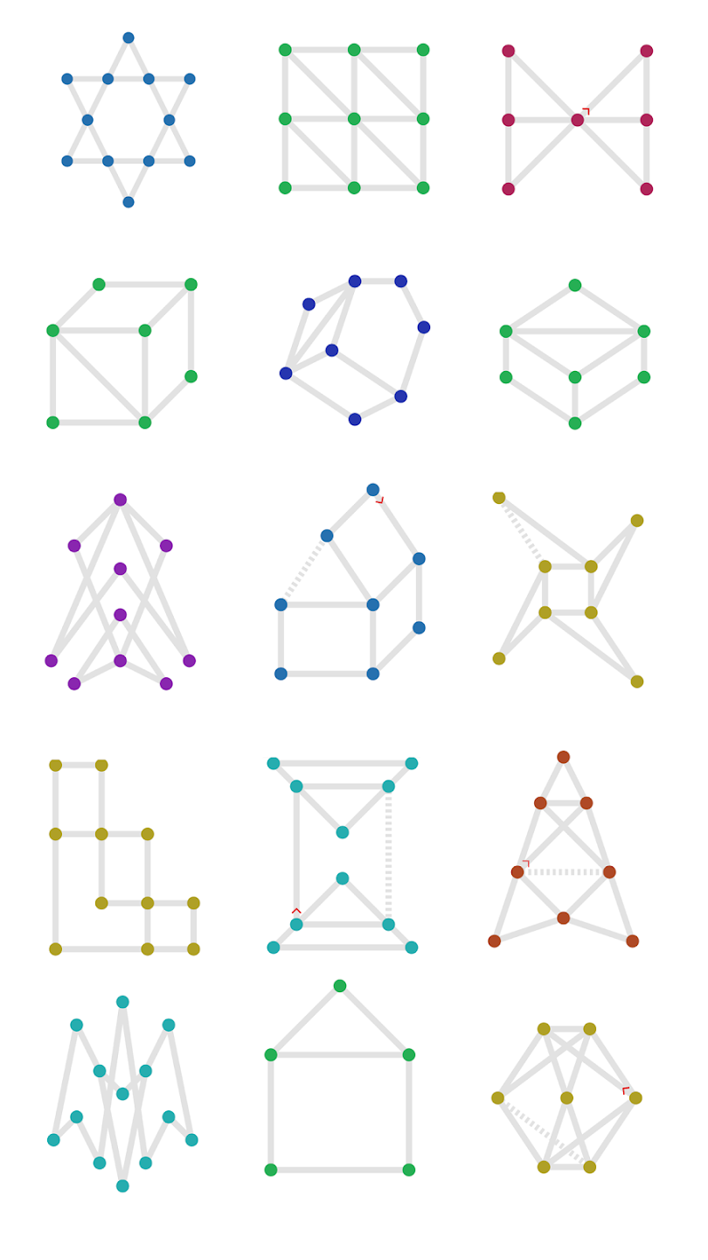
Drawing something using one pen stroke

Slide 20

Game
Draw the grid again in one stroke to minimize the number of segments, including counting overlapping segments

Slide 21

Discrete Mathematics II
Lecturer
Lecturer: Nguyễn Manh Phúc
Email: phuc.nguyenmanh@eiu.edu.vn
Zalo:

Slide 22
Discrete Math 2
Text books
Kenneth H. Rosen, Discrete Mathematics and Its Applications, 8E
Reinhard Diestel, Graph Theory, 6th Edition (2024), Springer-Verlag Heidelberg.
Slides
Moodle.
References
http://visualgo.net/

Slide 23
Learning Outcomes
After successful completion of this course, students are able to:
Create model for a practical problem in Graph language
Design algorithms, prove the correctness of the algorithms
Represent Graph problem in data structures and programming languages.
Apply graph algorithms and related data structures to solve specific graph problems

Slide 24
DISCRETE MATHEMATICS II
Graphs
Trees
Applications

Slide 25
Contents
Graphs
Graphs and Graph Models
Graph Terminology and Special Types of Graphs
Representing Graphs
Graph Isomorphism
Graphs Traversal
Connectivity
Applications of Graphs
Euler and Hamilton Paths
Shortest-Path Problems
Network flows
Planar Graphs

Slide 26
Contents
Tree
Introduction to Trees
Applications of Trees
Tree Traversal
Spanning Trees
Minimum Spanning Trees
Binary Tree
Balanced Tree
Binary Search Tree

Slide 27
Schedule
Theory: Mon, Thu (16:30 – 18:30)
Practice: Wed (10:30 - 13:30)
Attendance check: any time

Slide 28
Programming Languages
Prefer: Java, C#

Slide 29
Assessment
Labs (SPOJ): 20%
Submission after Dec 30(16:30 GMT+7).
Tests: 40%
2 practice tests
1-2 theory tests (offline or online, TBD)
Final Exam: 40%

Slide 30
Labs
SPOJ
Username: ei252[First name][Partial last name][1-9] (Maximum 14 characters) or any ei… accounts
Display name: student’s full name
Fill in Google Sheet: https://docs.google.com/spreadsheets/d/1bjW0L2wQxl4VQK155xMFm1cRfdT-0ro6yBYpuUwNkzk/edit?usp=sharing

Slide 31
FAQ
How many hours should student spend for this course per week?
Lectures: 4 hrs.
Labs: 3hrs.
Self-study: at least 9.5 hrs

Slide 32
CHEATING
Students will receive a zero on an assignment if any of these activities take place:
accepts an assignment from another student
supplies an assignment to another student
posts the assignment on the web, social networking site
shares their password with another student tot access to their assignments
work together on assignments and turn in the same and/or similar assignments.
turns in work that was obtained from other sources such as the web, friends…
leaves work available for others to copy from

Slide 33
Notes
Lectures: Full-charged Laptop
Turn on camera during online sessions

